Slide 1
Machine Learning in the Milieu
Predicting Genre from the Text

Slide 2

Alexander White
Using NLP to aid in Publishing
Natural Language Processing (NLP) is a branch of Machine Learning focused on deriving intelligent insights from computer reading of texts.
This study was an effort to develop a model which would correctly predict the most appropriate genre for a book from the contents of its text.
Deloitte AI Academy Capstone
January, 2023

Slide 3
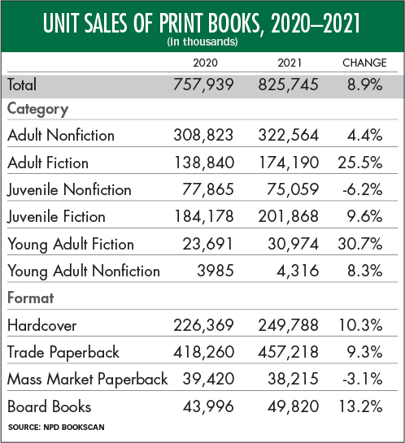
Why use NLP to predict genre?
Genre is one of the main ways people find new books.
Books that are labeled with appropriate genres are likely to find more success with their target audience.
While everyone “knows” what genre is, it can be difficult to define the genre of a text.
Table from Publisher's Weekly, "Print Books Had a Huge Sales Year in 2021" by Jim Milliot, 2022

Slide 4
Developing the model
Our initial hypothesis was that each genre would have its own subset of commonly used words.
We ingested 2000+ books from Project Gutenberg (an open use online repository).
The books were broken into standardized words (for example: am, are, were → is), which were counted for each book.
From these counts, we trained our model to predict the associated genre of a book.

Slide 5
[Placeholder: Results]

Slide 6
The Significance: Time is Money
What can this do for you?
What limitations still exist?
Reduce the workload on editors
Provide rapid suggestions for genre tagging of texts
Help identify “tricky” texts
Only considers word use, not style
Suggestions are not flawless
Only works for English language texts

Slide 7
Conclusions
Publishers can make use of Natural Language Processing to analyze books, even for less concrete ideas such as genre.
This can save man-hours and effort as well as assisting in classifying unusual texts.
The field still has plenty of room for growth and could be extended to many other aspects of the editorial and publishing business.

Slide 8
“[Genre] is what tells you where to look in a bookstore…[it’s] telling you which aisles to not bother going down. That’s the simplicity of book shelving in bookstores. It tells you what not to read.”
-Neil Gaiman, 2013
Thank you for your time.
Are there any questions?

